Slide 1

EDA W/ PANDaS
Karsten Nancy Tina Abdus

Slide 2
WHAT IS EDA?
Exploratory data analysis
Try to make sense of data.

Slide 3
WHAT IS PANDAS?
Library in Python
Tool for EDA

Slide 4
WHY IS EDA IMPORTANT

Slide 5



STEPS OF EDA PROCESS
STEP1 : DESCRIBING
STEP2 : CLEANING
STEP3 : VISUALIZING

Slide 6
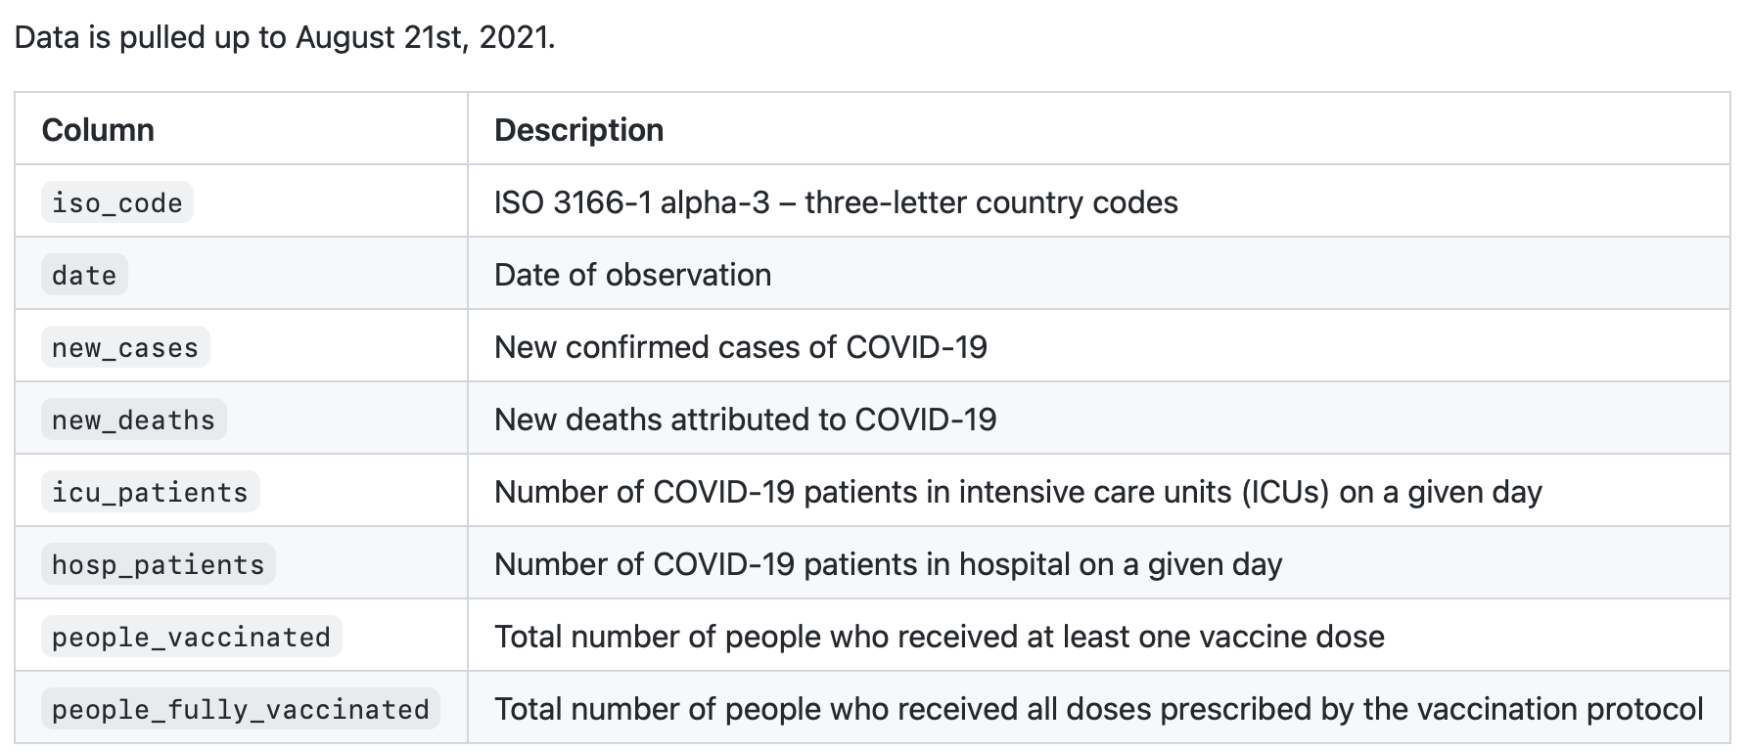
DATASET WE USE
https://github.com/owid/covid-19-data/tree/master/public/data/

Slide 7
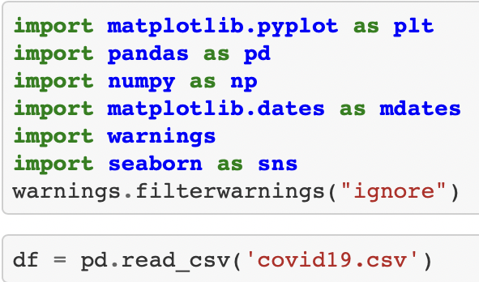
STEP ZERO – PREPARING

Slide 8
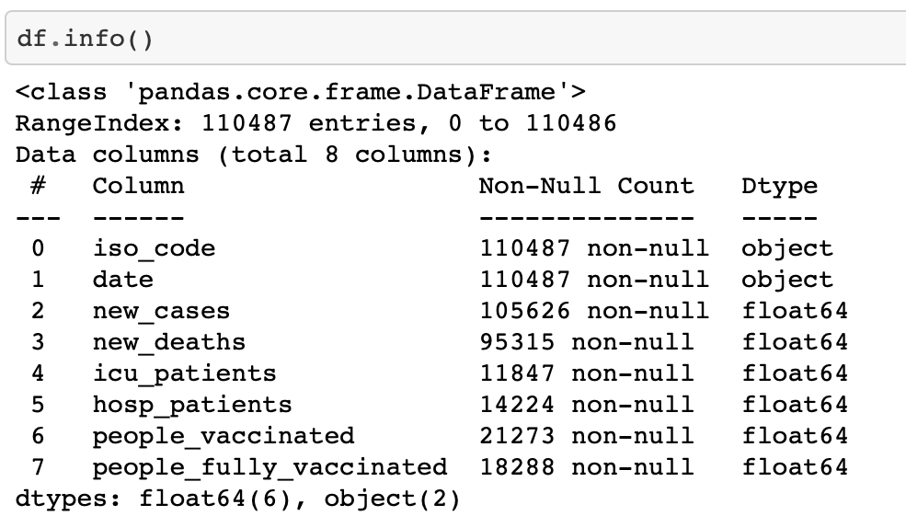
STEP ONE - DESCRIBING

Slide 9
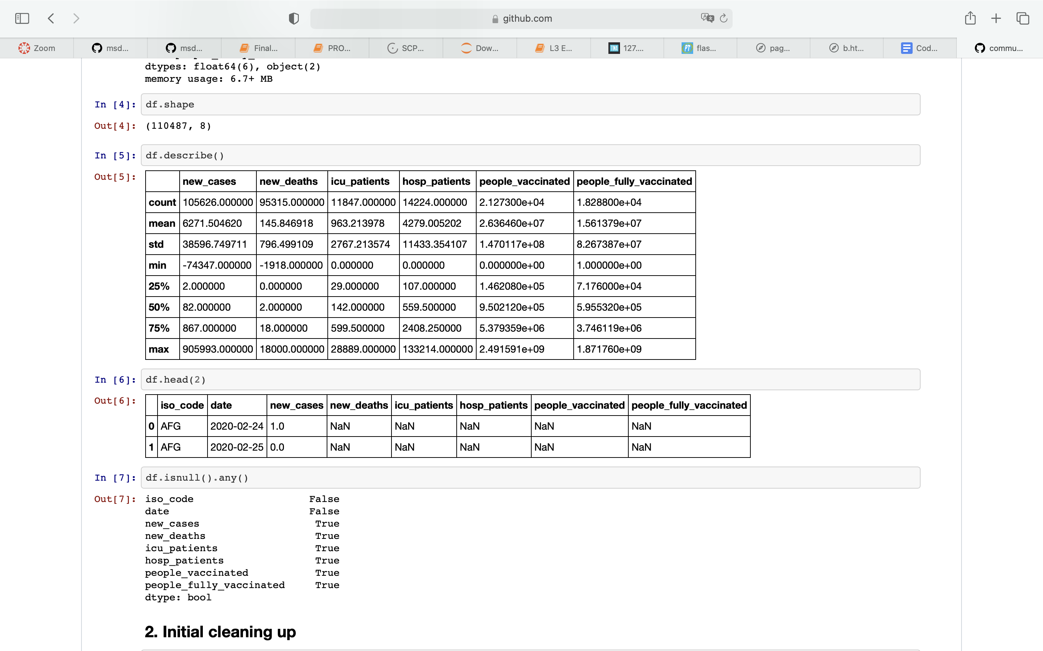
STEP ONE - DESCRIBING

Slide 10
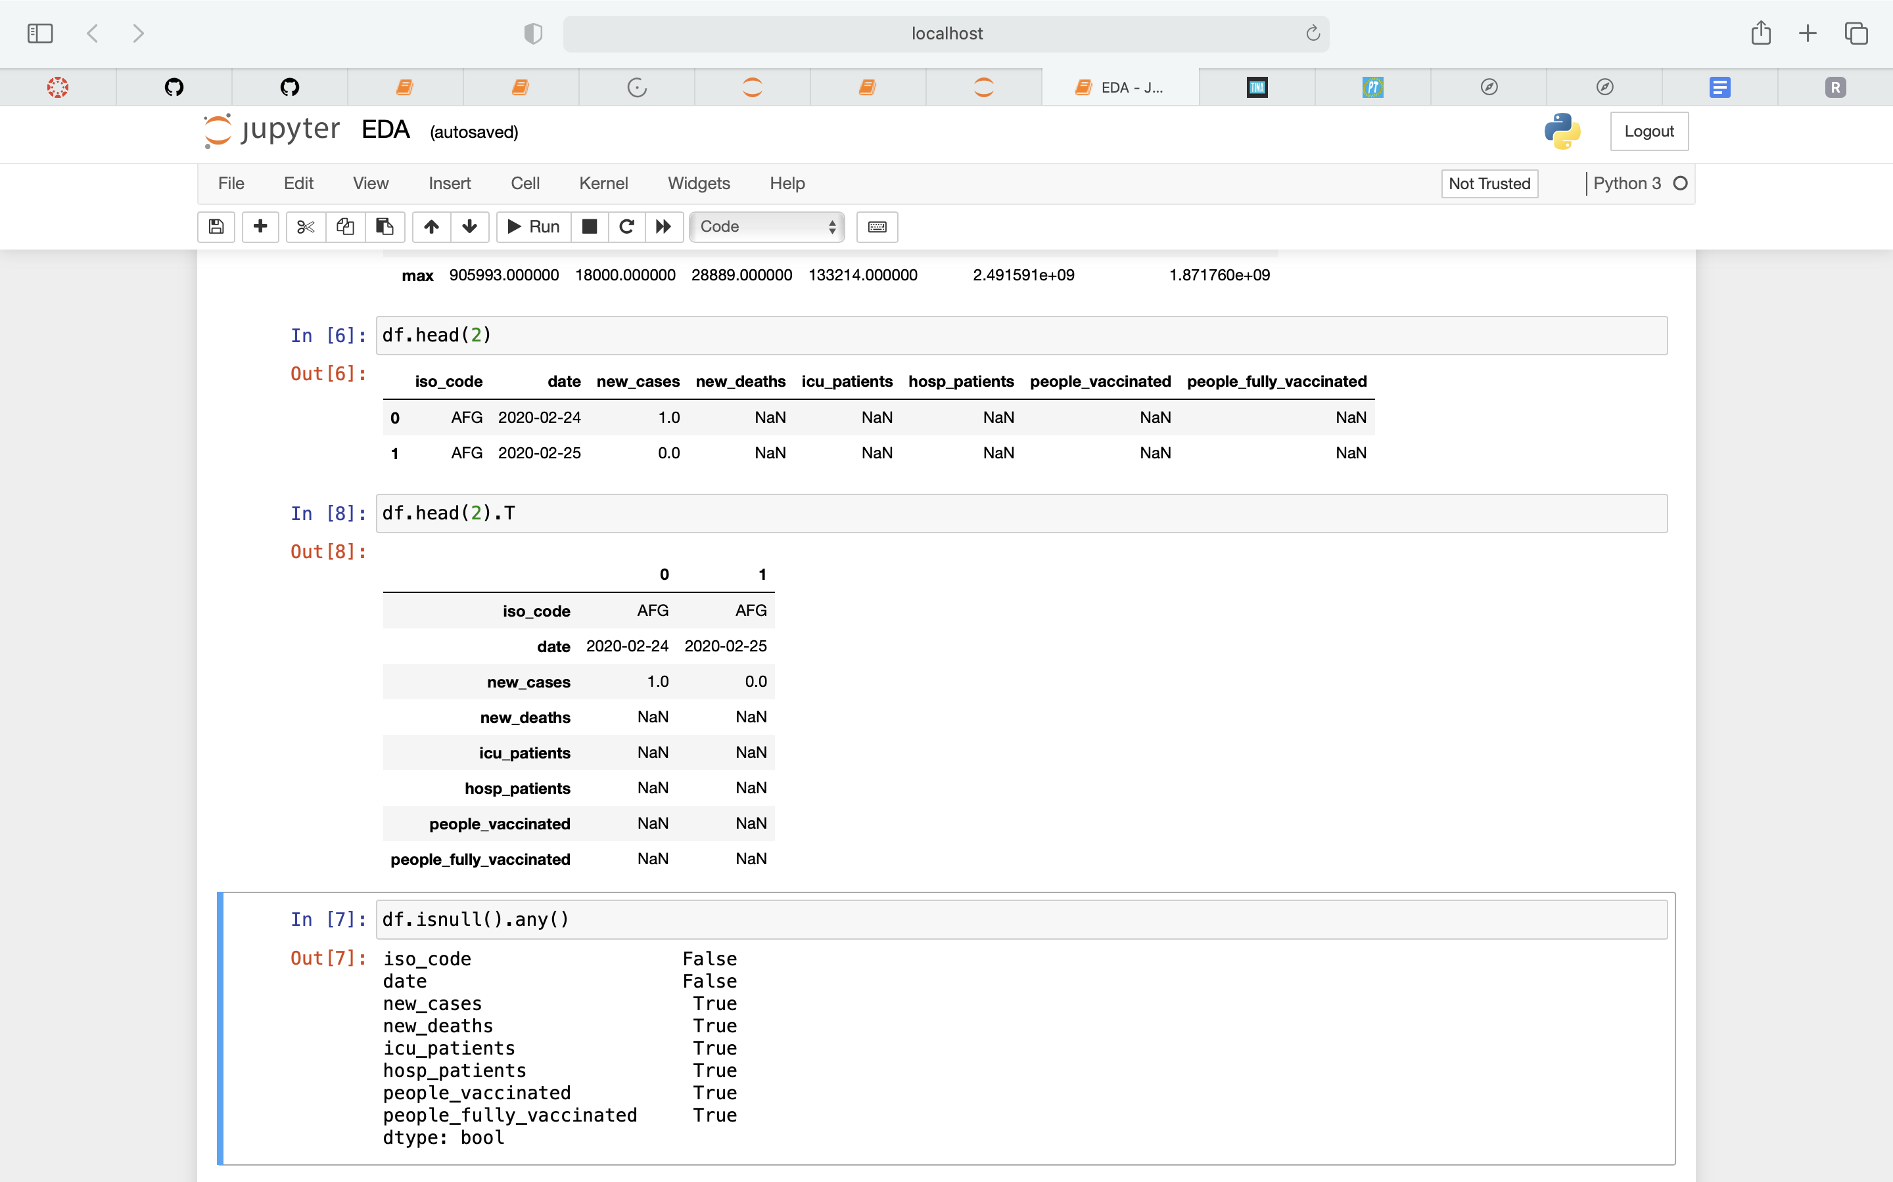
STEP ONE - DESCRIBING

Slide 11
STEP ONE - DESCRIBING

Slide 12
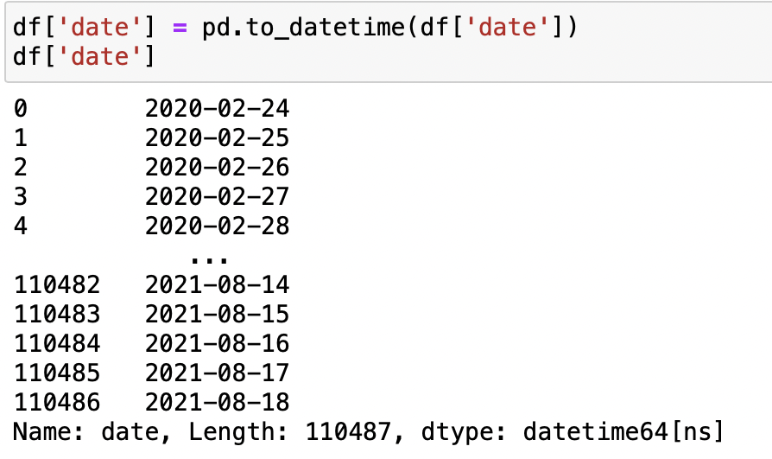
STEP TWO - Cleaning

Slide 13
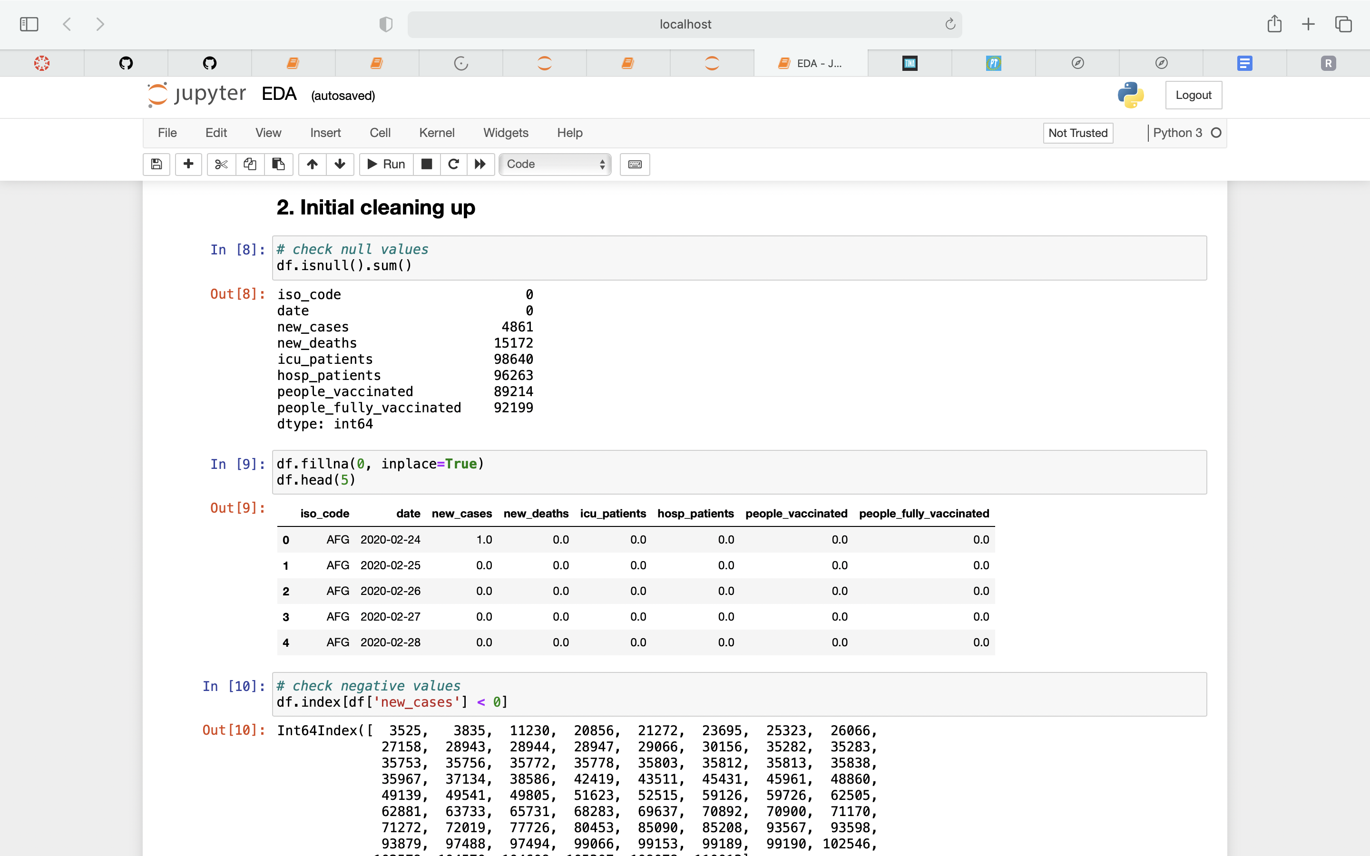
STEP TWO - Cleaning

Slide 14
STEP TWO - Cleaning

Slide 15
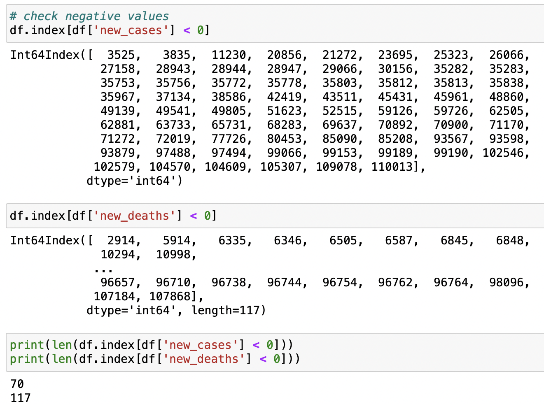
STEP TWO - Cleaning

Slide 16
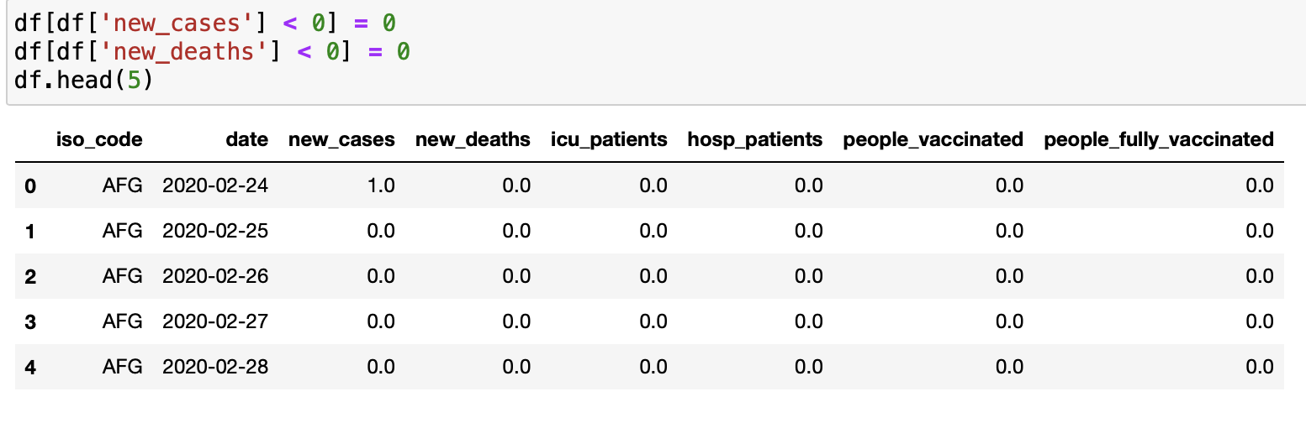
STEP TWO - Cleaning

Slide 17
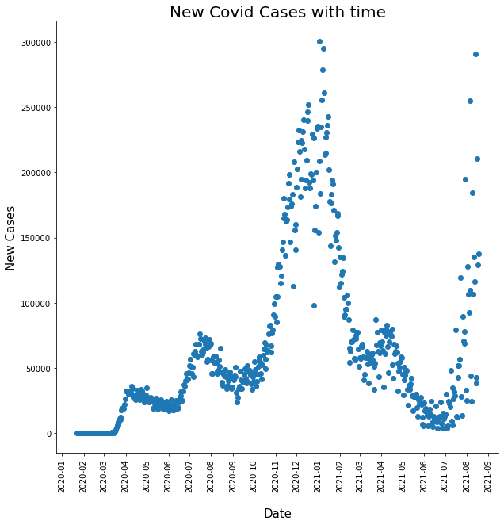
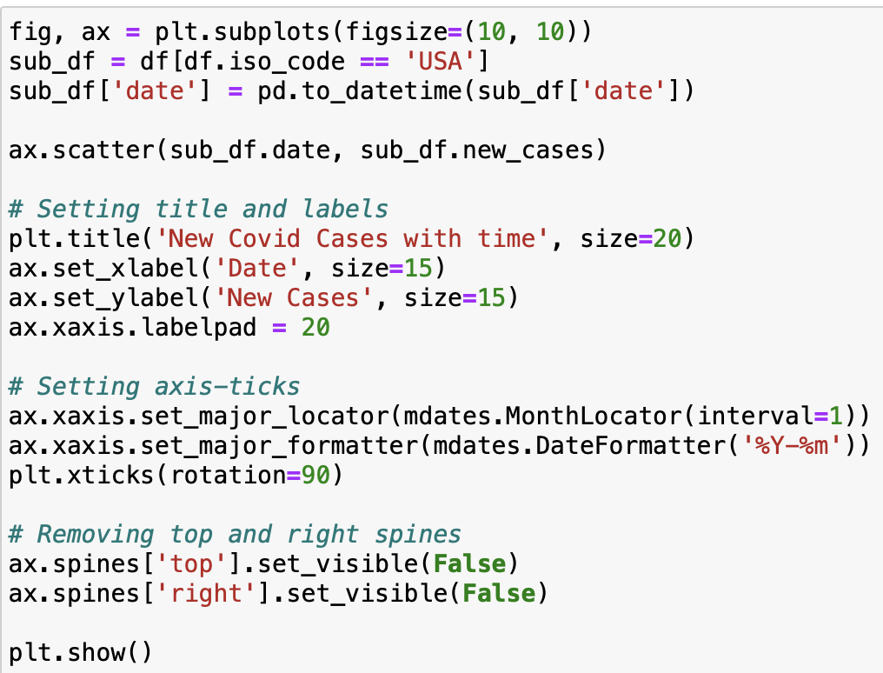
STEP THREE - VISUALIZING

Slide 18
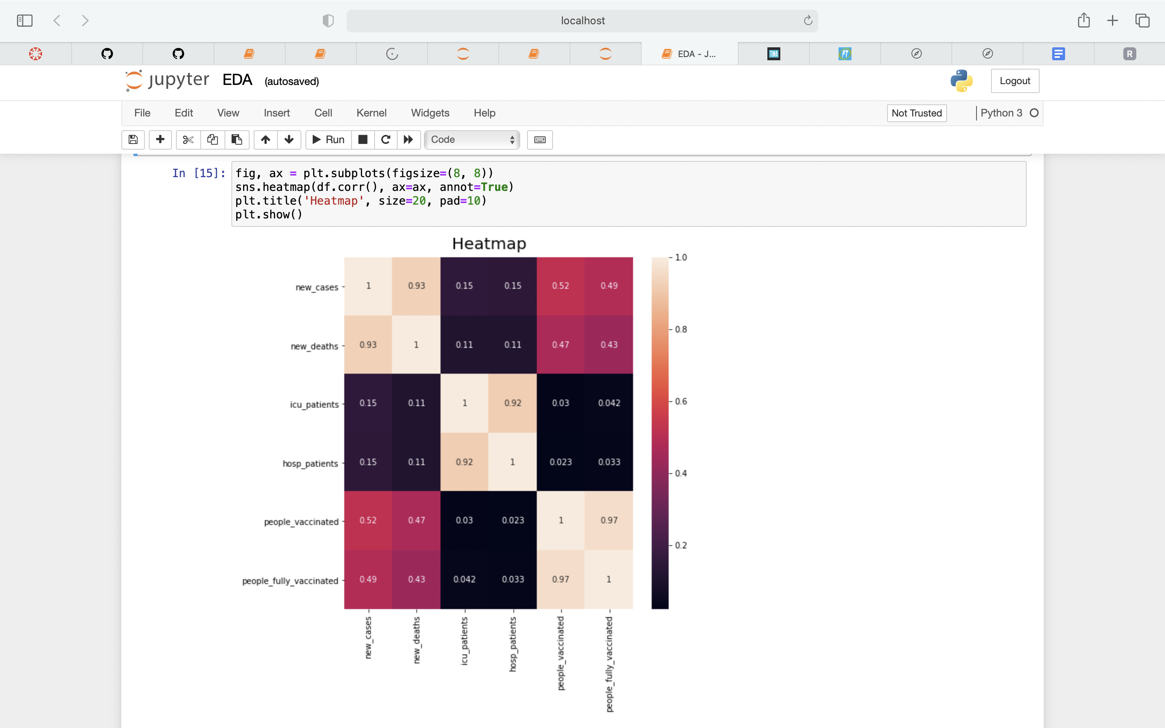
STEP THREE - VISUALIZING

Slide 19
Conclusion
Describing
Cleaning
Visualizing

Slide 20

QUESTIONS?

Slide 21

Thank you

